Slide 1
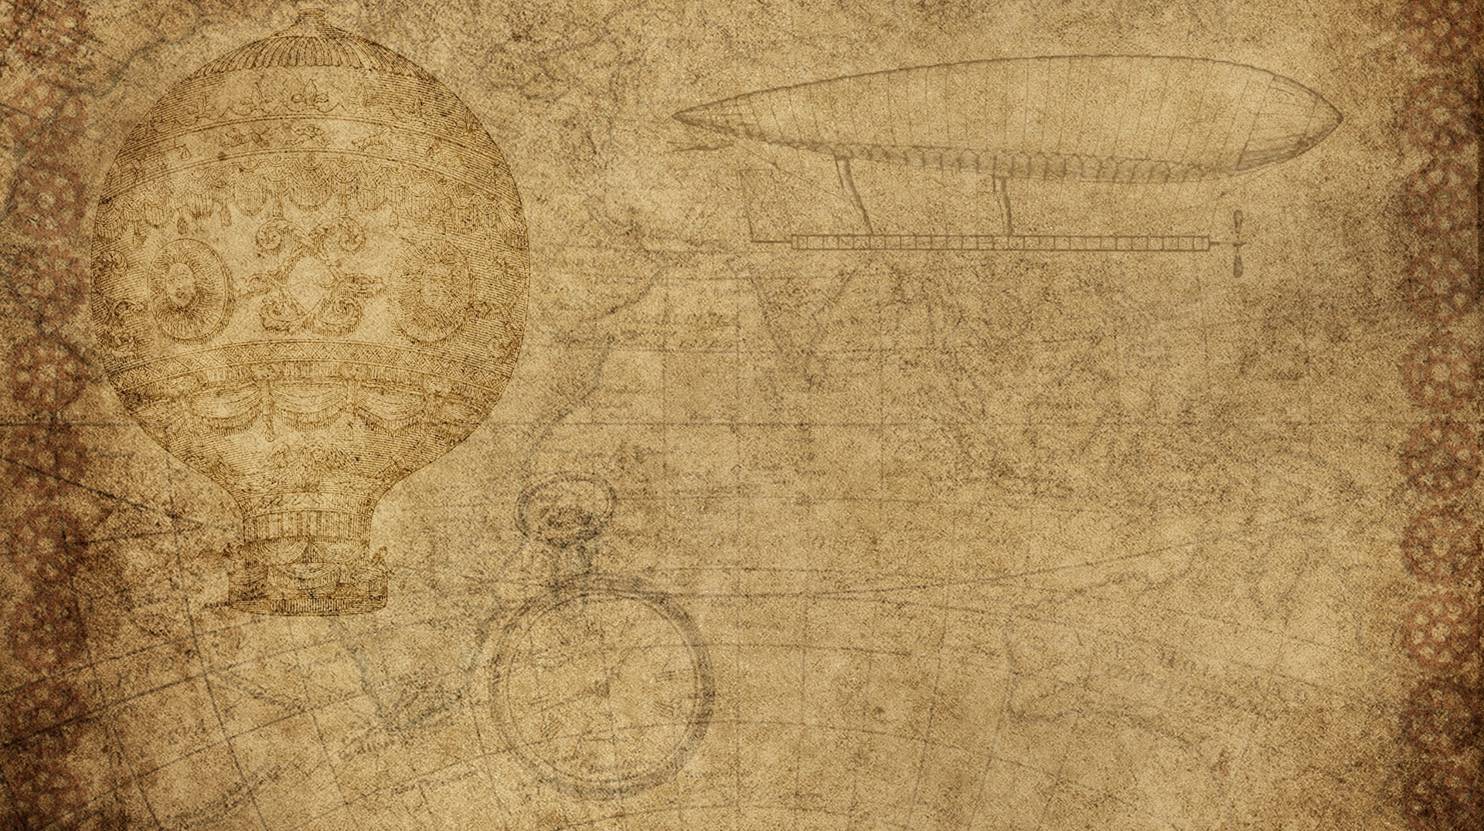
Potato Disease Classification
Mentor : mr rajesh kumar tripathi
Team Members :
Shivam TRIPATHI (181500675)
Akash gupta(181500058)
aBHISHEK GUPTA

Slide 2
Outline
Introduction
Motivation
Research Objective
Features
Dataset
Algorithms
Requirements
Flow Diagram

Slide 3
Introduction
Leaf detection is a field of study under the image recognition field of computer vision. Recognising leaves is of atmost importance in biodiversity conservation.
The major project, detection of diseases in leaves, is also another important milestone in conserving not just biodiversity but also saving crops from disease spread.

Slide 4
Motivation
Farmers who grow potatoes are facing lot of economic losses every year because of various diseases that can happen to a potato plant.
There are two common diseases known as early blight and late blight early blight is caused by a fungus and late blight is caused by a specific microorganism and if a can detect these diseases early and apply appropriate treatment then it can save lot of waste and prevent the economic loss.
The treatments for early blight and late blight are little different so it's important that you accurately identify what kind of disease is there in that potato plant.

Slide 5
In India, Agriculture is the main source of income.
Recognition of crop diseases are the major technical and economical importance in the agricultural Industry.
If crop disease is not identified at early stageit can affect to other crops too.
Disease affected plants constitute 10-30% of the total crop loss.
So there is strong motivation for introducing a system which can quickly and easily trained to work with different lightings, different angles to identify these types of diseases

Slide 6
research objective
Basically we have plant village datset that is available on kaggle. The images used in the dataset are from Switzerland region, we do not have any dataset of potato leaf from Indian region, but we have a datset from Pakistan region, as India and Pakistan share alike geographical condition so there will be the maximum similarity between the leafs of potato from Indian region and Pakistani region. So first we train and test our model on Plant Village dataset then we will test our real accuracy on Pakistan dataset.

Slide 7
Features
In our case we need to collect images of a healthy potato plant leaf and the potato plant which has early blight or a late blight disease.
We'll start with data collection first and then we'll look into model building. We'll also look into some of the ML Ops using TF serving.
We will build our backend server using fast API and then we'll deploy the model to Google Cloud
and we'll have Google Cloud functions and that these functions will be called by a mobile app written in React Native

Slide 8
dataset
The dataset used in this study consist of potato leaf images from PlantVillage dataset. The dataset consists of 38 image classes; in this study, only three classes used for classification. The three leaf image classes used for disease classification system are infected by Late Blight, infected by Early Blight, and healthy potato leaves. The used dataset for the proposed system consists of 2150 colored leaf images with resolution 256×256 pixels. There are 1000 leaf images with Late Blight, 1000 leaf images with Early Blight, and 210 images of an uninfected or healthy leaf.Below figures shows samples of infected leaves and not infected leaf from the dataset
Data Set Link - “https://www.kaggle.com/emmarex/plantdisease”

Slide 9
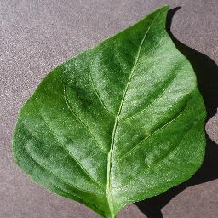
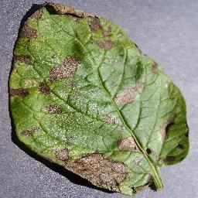
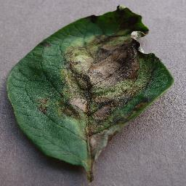
Sample Images
Healthy
Early Blight
Late Blight

Slide 10
Algorithm used : cnn
CNN(Convolutional Neural Network)
In Deep Learning, a Convolutional Neural Network(CNN) is a class of deep neural networks, CNN is a type of artificial neural network, which is widely used for image/object recognition and classification. Deep Learning thus recognizes objects in an image by using a CNN. CNNs are playing a major role in diverse tasks/functions like image processing problems, computer vision tasks like localization and segmentation, video analysis etc.

Slide 11
Requirements
Hardware Requirement
Software Requirement
Operating System | Windows 10
Front End | React JS, React Native
Backend Server and ML Ops | tf serving, FastAPI
Code Editor | Jupyter Notebook,VS Code
Model Optimization | Quantization, Tensorflow lite
Web Browser | Google Chrome
Deployment | GCP (Google cloud platform, GCF)
Processor | 1.6 GHz or Faster Processor
RAM | 4 GB
Disk Space | 10 GB of Available Hard Disk
Graphic | DirectX 9-Capable Video Card
Display | 1024 X 768 or Higher Resolution

Slide 12
flow diagram
1 . Import the used tools and libraries
2 . Read the dataset
3. Data Pre Processing
4. Model Building
5. Model Training and Testing
6. Save the model
7. Deploy the Model
8. Upload the leaf image through Web Page/App
9. Predict the Result

Slide 13
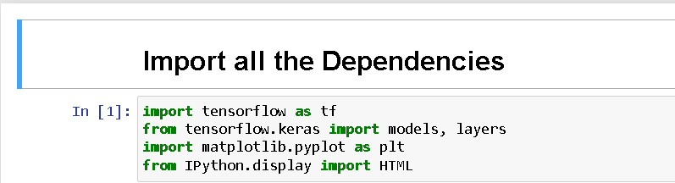
Importing the used tools and libraries

Slide 14
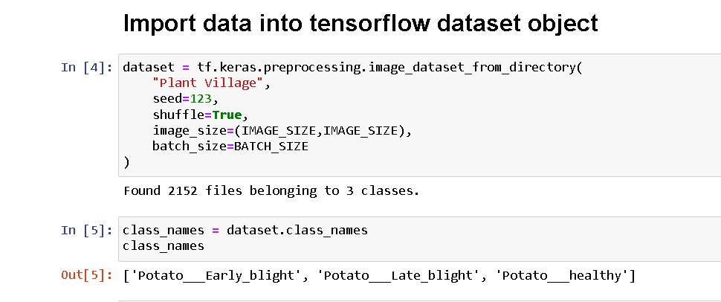
Read the dataset

Slide 15
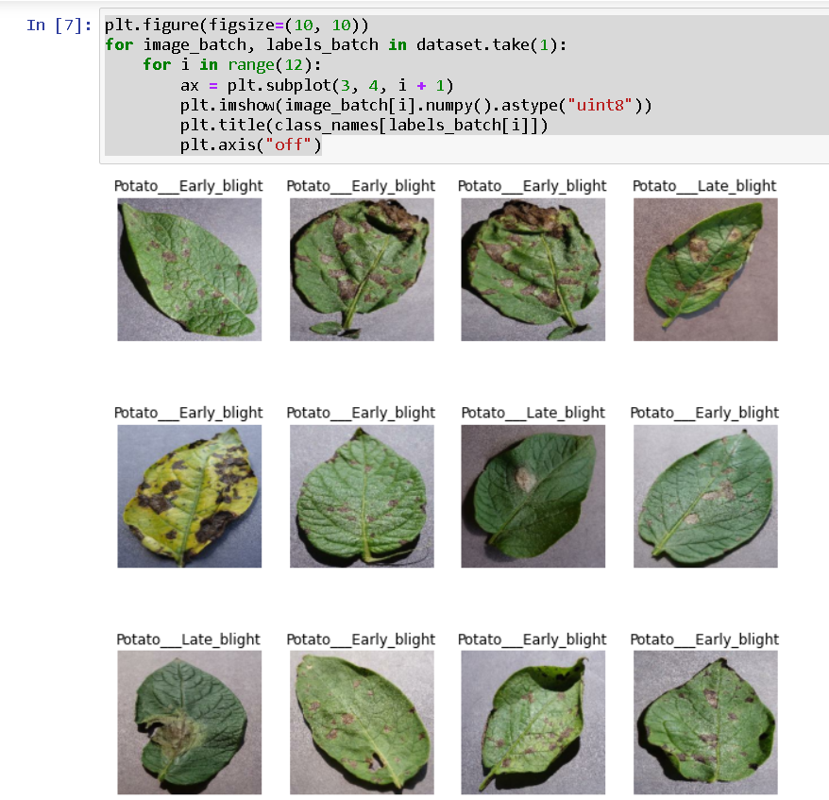
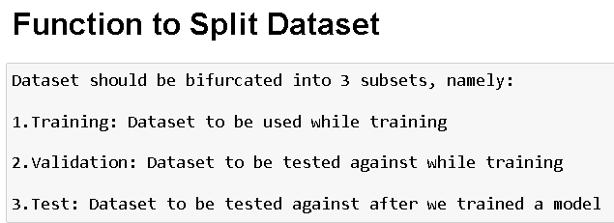
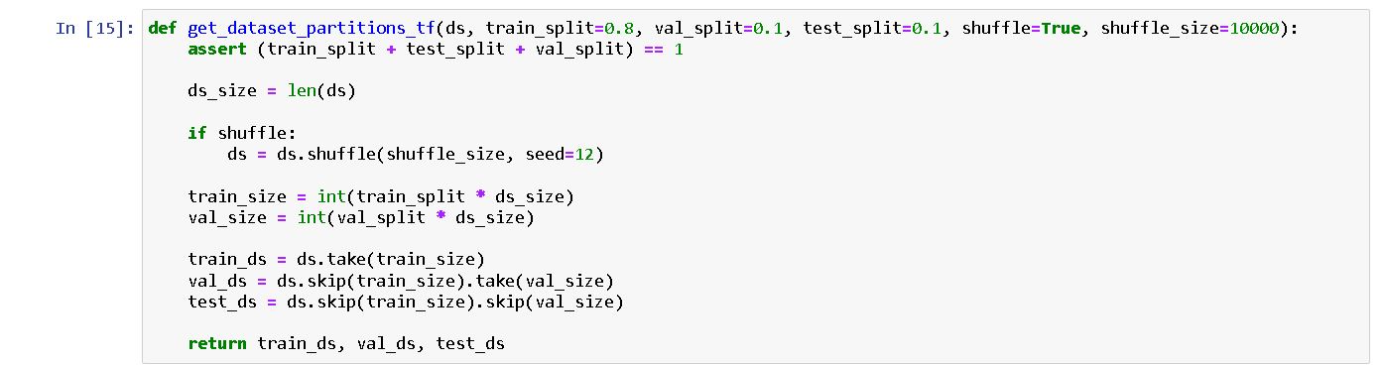
Data Pre Processing

Slide 16
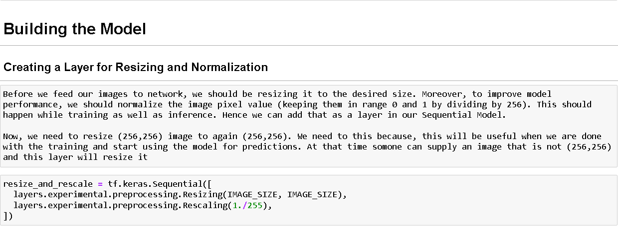
Model Building

Slide 17
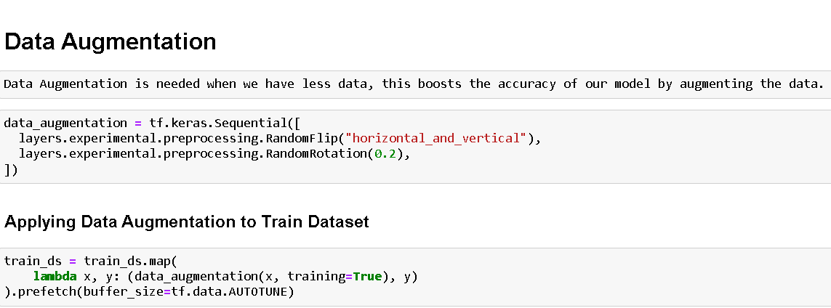
data augmentation and model architecture

Slide 18
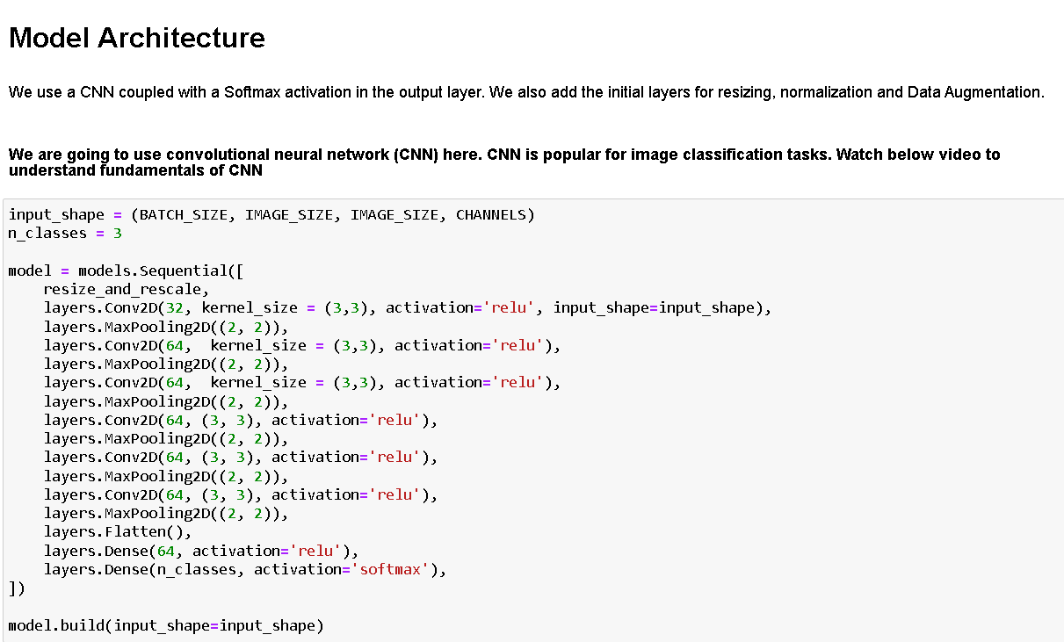

Slide 19
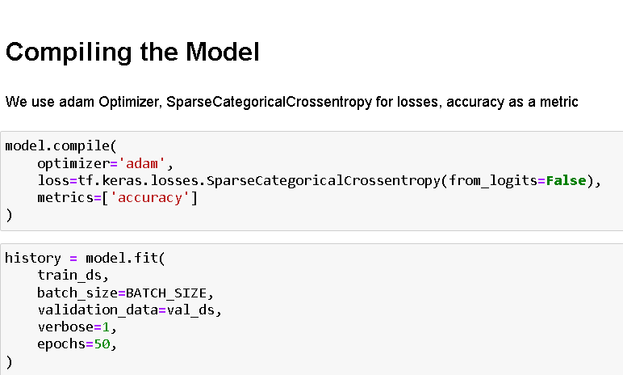
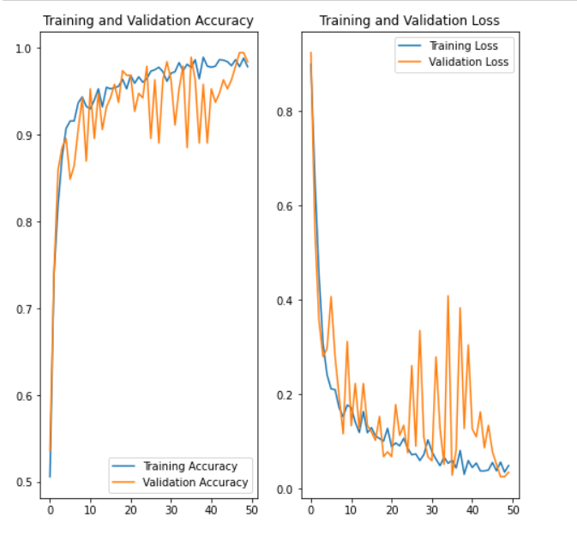
compiling the model

Slide 20
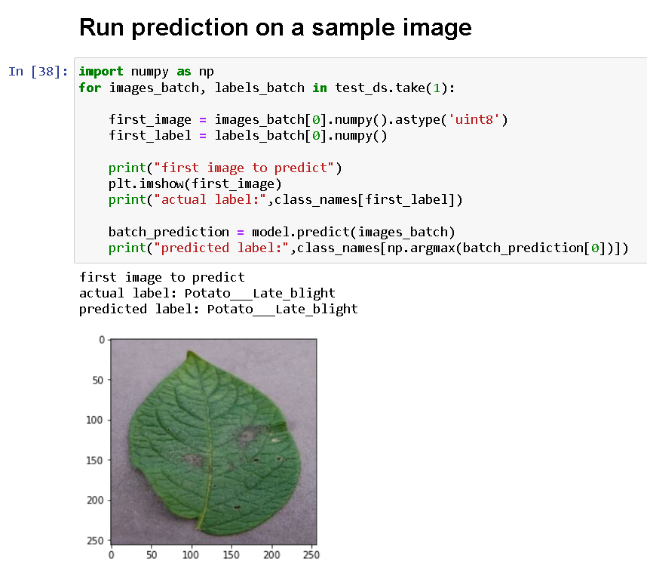
Model Training and Testing

Slide 21

Thank you

